Slide 1
Online Tools for Academic Writing
EAP Workshop
Belen Vicens
Have you not registered yet?
Register now on your mobile device at:
http://tinyurl.com/EAPregister

Slide 2
English for Academic Purposes (EAP)
cslc.nd.edu/eap
EAP Fellows
Belen Vicens
Ricky Klee
Courses
Pronunciation
Writing
Presentations
Workshops
Tutoring
329 DeBartolo Hall
cslc.nd.edu

Slide 3
EAP Christmas Potluck Party
Who? EAP students; families welcome
What? Potluck Party
When? Thursday, Dec.10
What time? 5-7pm
Where? The Center for the Study of Languages & Cultures

Slide 4
Overview
1. Dictiona-ries
Wordreference.com
2. Google News
Collocations
3. Zotero
Citation manager
Merriam Webster’s Learner
Oxford Learner’s
Idioms
Frequency index
4. ESL Websites

Slide 5
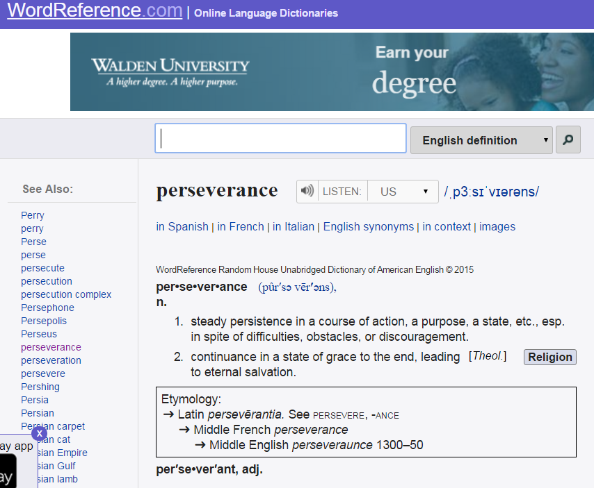
1. Dictionaries: WordReference.com
Search in your native tongue
Listen to the pronunciation of a word
Find synonyms
Check forum discussion for particular usages

Slide 6
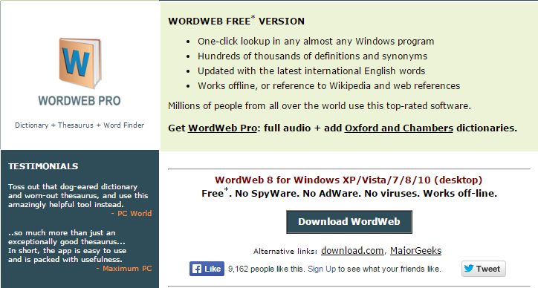
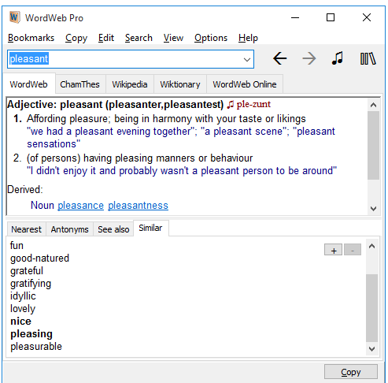
1. Dictionaries: WordWeb (standalone)
http://wordweb.info/free/

Slide 7
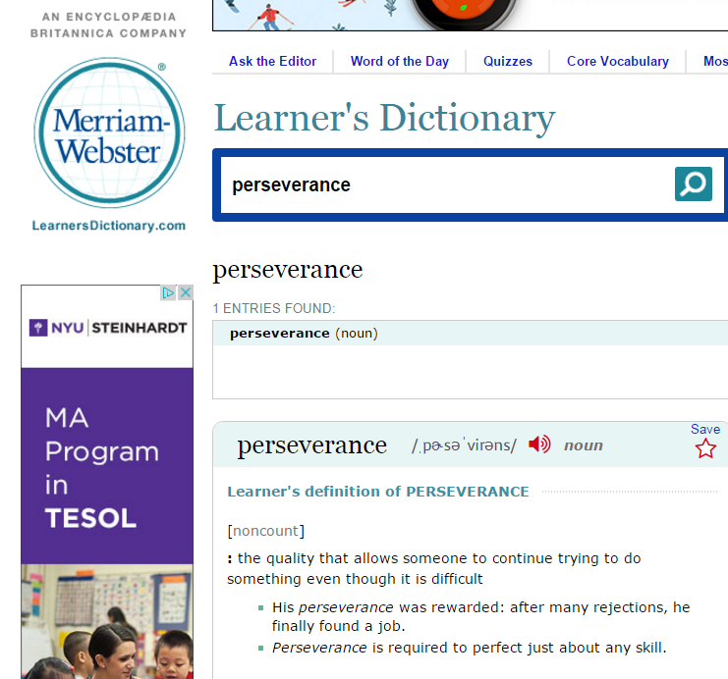
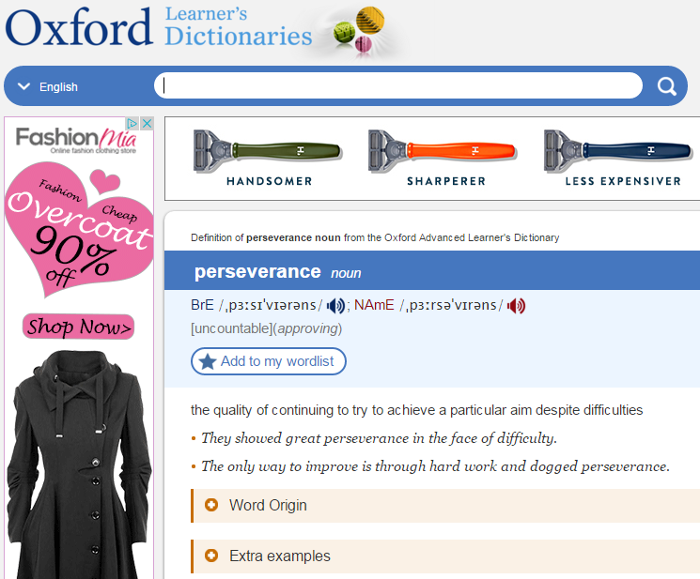
1. Dictionaries: Merriam-Webster’s and Oxford’s Learners Dictionaries
http://www.learnersdictionary.com/
http://www.oxfordlearnersdictionaries.com/

Slide 8
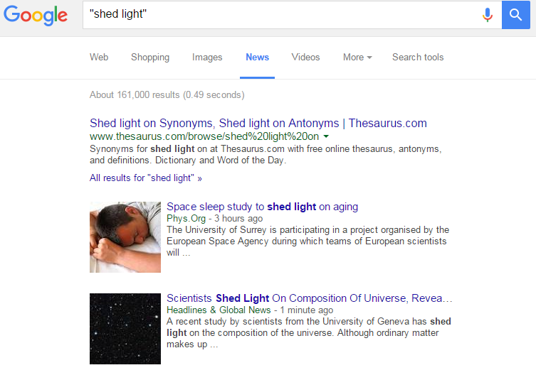
2. Google News
Type in the word or phrase you are looking for.
Use quotation marks to define the precise word order
If you are unsure about what preposition goes after “shed light,” try first with “to” and then “on”
See the frequency indices for both prepositions
Make a decision

Slide 9
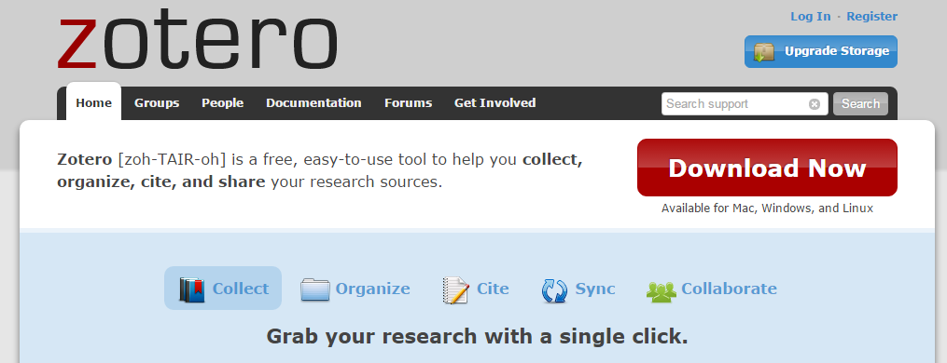
3. Citation Manager: Zotero
https://www.zotero.org/

Slide 10
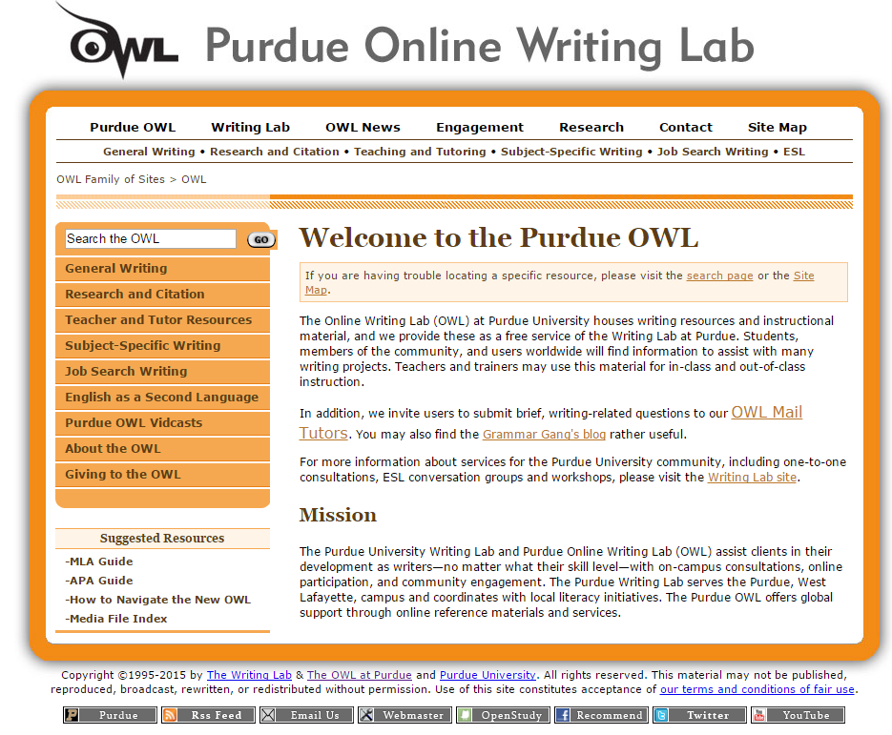
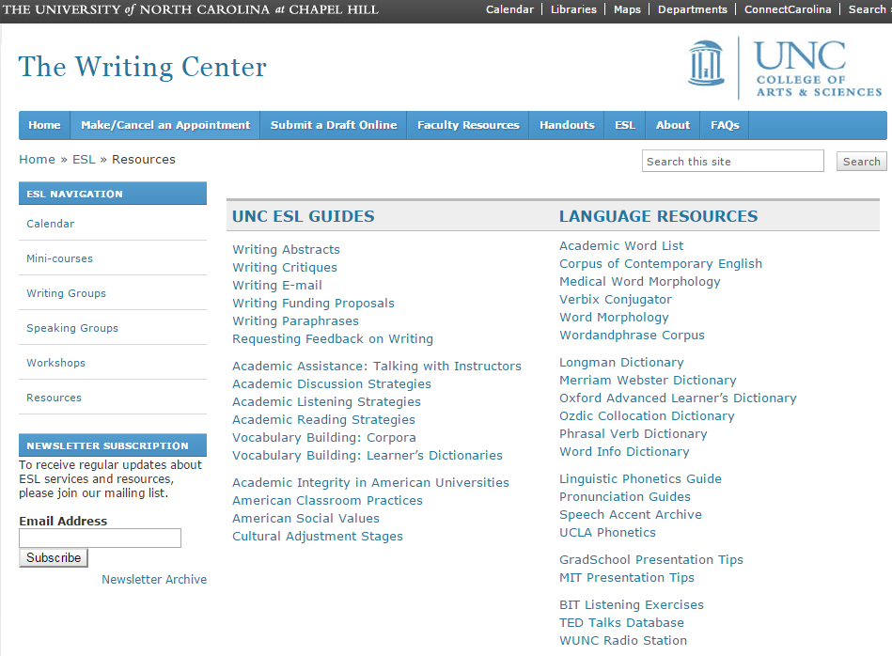
4. ESL Websites
http://writingcenter.unc.edu/esl/resources/
https://owl.english.purdue.edu/owl/

Slide 11
Final Business
To view the slides from this presentation, go to our newsfeed at https://cslc.nd.edu/news-and-events/
Please take a few minutes to fill out the following survey: http://goo.gl/FA7YH2
Thank you!

